Slide 1

Nutrition & living standards in Western Europe & USA in the late nineteenth century
Ian Gazeley, Rose Holmes, Andrew Newell, Kevin Reynolds and Hector Rufrancos
University of Sussex

Slide 2
Fogel Escape from Hunger (2004)
IR required sustained physically demanding work (10 hrs/day)
Implies daily energy requirement of +3500 Kcal
‘Physiological capital’ increased over time, as diets provided more energy and both physical stature and labour productivity increased
Investigate the extent to which late 19c food consumption from HH budget data is consistent with ‘physically demanding work’ in USA, UK, France, Germany & Belgium.

Slide 3
1889/90 United States Commissioner of Labor
8,544 households 6 countries: USA (6809), UK(1024), Belgium(124), Germany(200), France (335), Switzerland (52)
Export trades & McKinley Tariff - HH in nine industries: Pig Iron, Bar Iron, Steel, Coal, Coke, Iron Ore, Cotton, Wool, Glass.
Higher than average incomes. Male bread winner households (not France)
Not a new source, extensively analyzed. Data extracted by Haines (1979).
Fixed format structure - provides comprehensive details of HH structure & characteristics, income, expenditure.
Analysis of diets/nutrition, Gazeley 1985 (UK), Logan 2006 & 2009 (UK and USA Kcal only), Gazeley & Newell 2015 (UK Kcal only)
Notes:
About ½ in textiles (3958) and ¼ in iron & steel (2381).
The Tariff Act of 1890, commonly called the McKinley Tariff, was an act of the United States Congress framed by Representative William McKinley that became law on October 1, 1890. The tariff raised the average duty on imports to almost fifty percent, an act designed to protect domestic industries from foreign competition.]Protectionism, a tactic supported by Republicans, was fiercely debated by politicians and condemned by Democrats. The McKinley Tariff was replaced with the Wilson–Gorman Tariff Act in 1894, which promptly lowered tariff rates.

Slide 4
Energy and nutrient availability
Household unit of assessment.
Quantity of foods consumed. USCL fixed format with 21 foods reported (plus alcohol). 11/21 expenditure & quantity, 10/21 expenditure only.
Source retail prices 10/21 elsewhere to derive implicit quantities (includes milk, flour, bread, cheese). For USA prices by state. No regional information given for other countries.
Other food expenditure (5-10% of food expenditure).
No self-resourcing info (though livestock, garden recorded in USCL US budgets).

Slide 5
Problems with USCL conversion
Food quantity estimates not that sensitive to chosen price where external prices needed (10/21 foods USCL survey)
Used Aldrich prices and USCL 1903 (by US state)
Converted to constituent nutrients using McCance & Widdowson’s food composition tables of @1,000 different foods for 29 different nutrients
Adjusted for fortification, include Mc&W waste assumptions. Mix of cooked and raw food (e.g. apple (raw), cabbage (cooked))
Nutritional estimates sensitive to assumptions relating to inclusion of specific foods within large food groups. (e.g. meat where waste & fat content on/off bone, fatty/lean cuts vary).

Slide 6
Daily estimates of Kcal/capita
 | UK | USA | GERMANY | FRANCE | BELGIUM
Without alcohol | 2195 | 2382 | 1518 | 1653 | 2049
With alcohol | 2227 | 2419 | 1559 | 1728 | 2134
Alcohol (as recorded) | 32 | 37 | 41 | 75 | 85
Daily estimates of Kcal/OECD Equivalent Adult
 | UK | USA | GERMANY | FRANCE | BELGIUM
With alcohol | 4104 | 4431 | 3008 | 3147 | 3961
OECD Eq. Ad | 2.56 | 2.66 | 2.79 | 2.59 | 2.85
OECD Equivalence scale:
Adult 1 + 0.5 addition adult > 16 yrs
Child 0.3

Slide 7
Fogel and Physical activity levels
Energy requirements vary by sex, age, weight & physical activity.
1890s individuals smaller and shorter, with higher PAL, than century later. Body Mass determines BMR, PAL multiple of BMR
According to Fogel, late 19c US males BMI = 22, BMR = 1631 Kcal/day.
PAL 2.2 => 3590 Kcal/day (energy to sustain 10 hours heavy work day)
UK 1991, Men age 30+, 62.5Kg, PAL 2.2 => 3535Kcal/day
UK 1991, Women age 30+, 47.5kg, PAL 1.6 (moderate activity) => 1923Kcal/day (2747 Kcal/day if working, PAL 2.2)

Slide 8
Energy needs of children relative to adults
 | Equivalence Scale |  | Equivalence Scale
Men 30-59 | 1.0 | Women 30-59 | 0.56 (0.77 PAL 2.2)
Men 19-29 | 0.99 | Women 19-29 | 0.52 (0.71 PAL 2.2)
Boys 15-18 | 0.77 | Girls 15-18 | 0.59
Boys 11-14 | 0.62 | Girls 11-14 | 0.53
Boys 7-10 | 0.55 | Girls 7-10 | 0.49
Boys 4-6 | 0.48 | Girls 4-6 | 0.43
Boys 1-3 | 0.35 | Girls 1-3 | 0.33
Boys <1 | 0.21 | Girls <1 | 0.19
Calculated by authors from from DH1991 RNI

Slide 9
Energy & nutrient availability relative to RNI
UK 1991 Dept Health Recommended Nutritional Intakes (derived from FAO/WHO 1980s recommendations). RNI designed to maintain good health, not level below which disease evident.
0.5 RNI likely benchmark for disease (Harper (1987) Annual Review of Nutrition)
RNI calculated for each household for each nutrient, taking account of age & sex. Equivalence scales vary by nutrient.
Ratio of HH nutrient availability/HH RNI, where > 1 desirable, < 0.5 likely to indicate nutritional deficiency (dotted & solid red lines respectively)

Slide 10
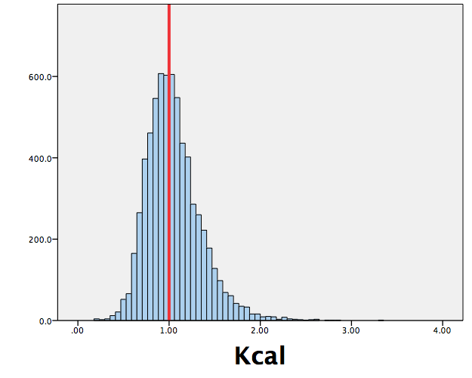
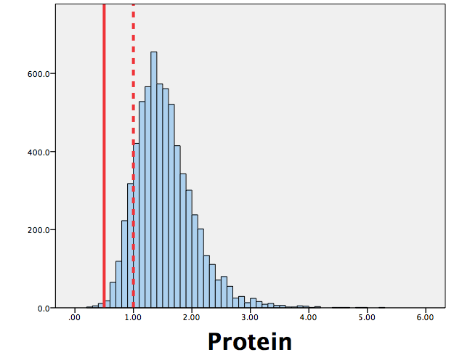
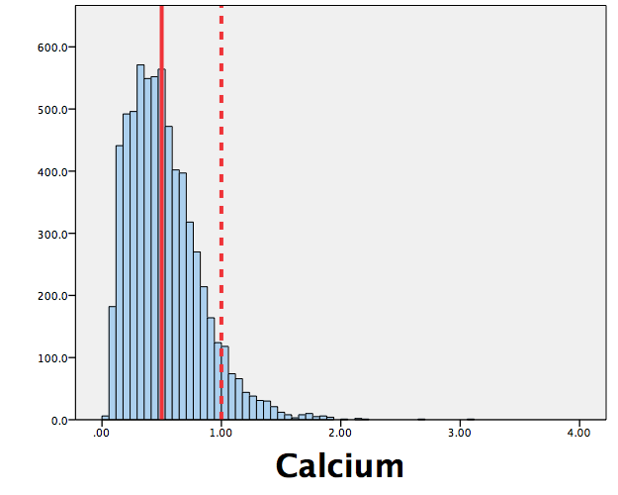
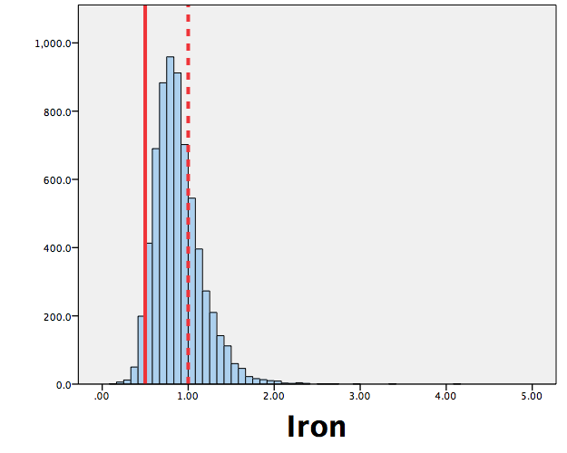
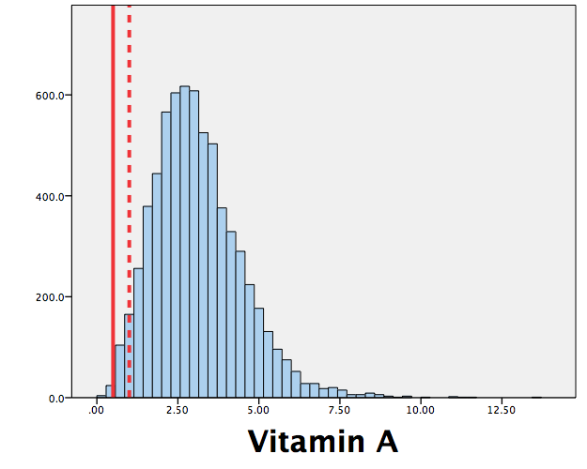
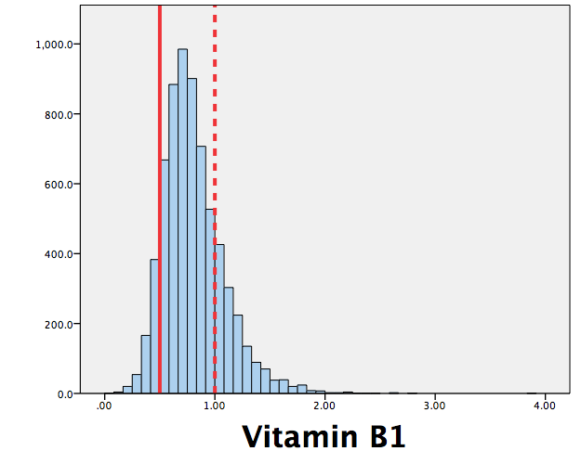
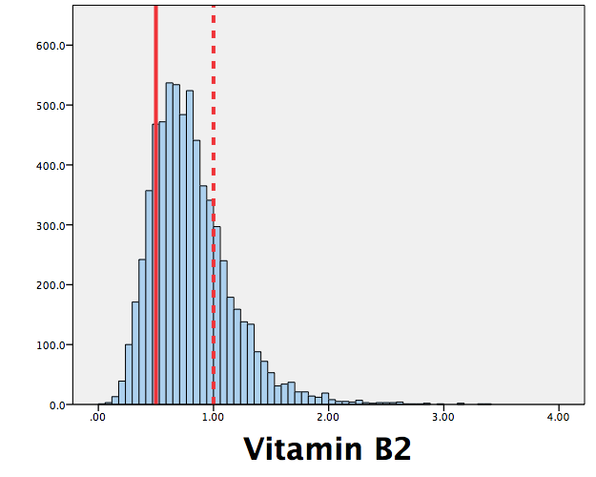
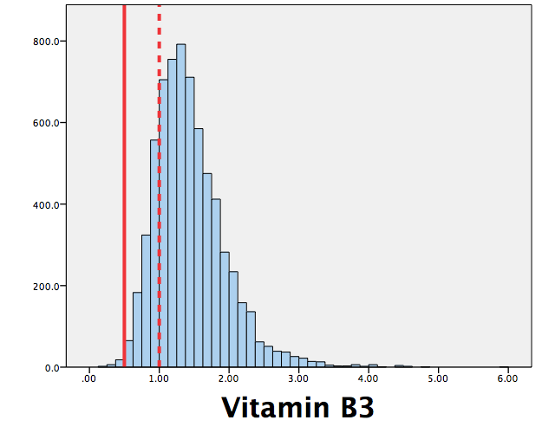
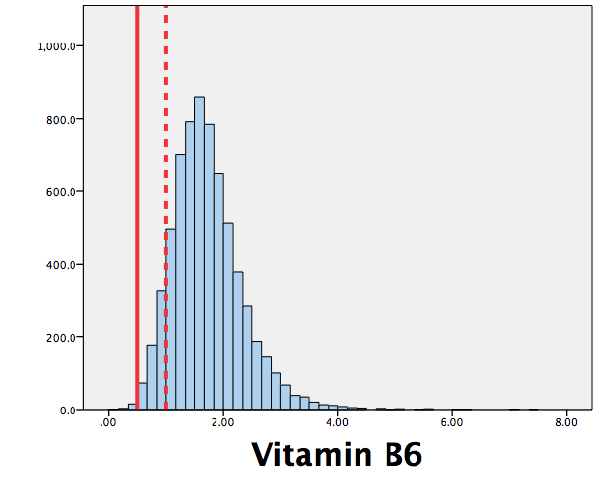
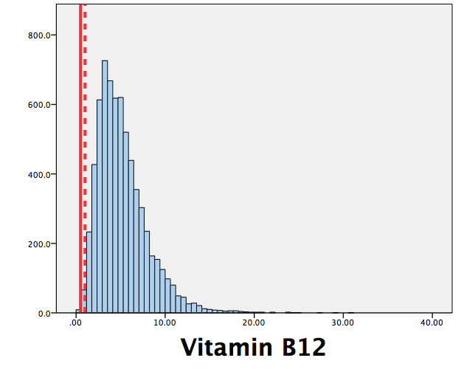
USA 1889-90
Energy & Nutrient Availability (inc alcohol) relative to UK 1991 Dept. of Health Recommended Nutrient Intake

Slide 11
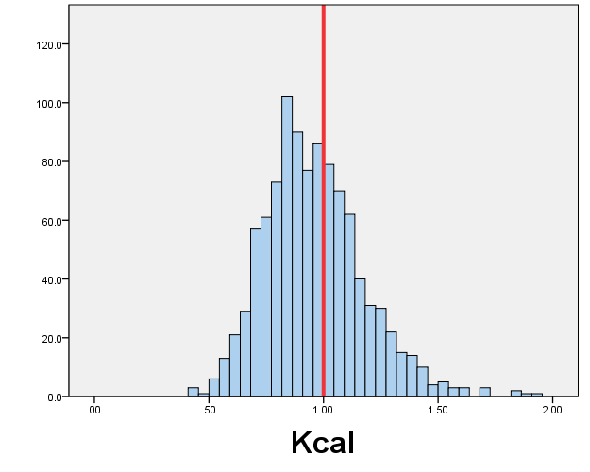
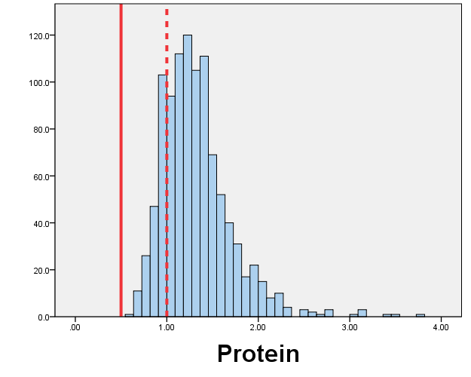
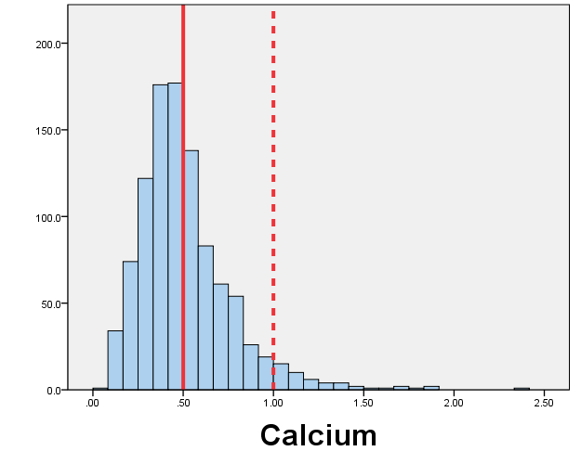
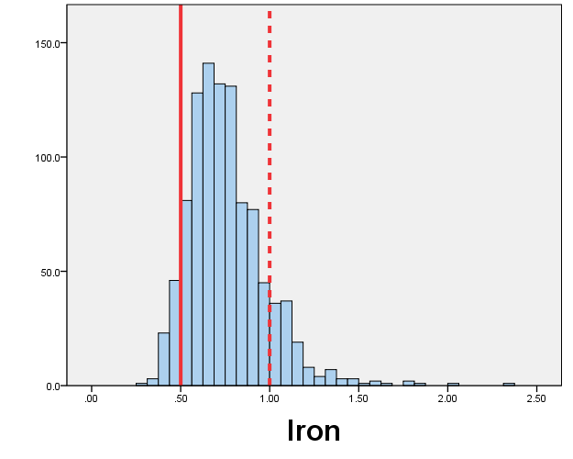
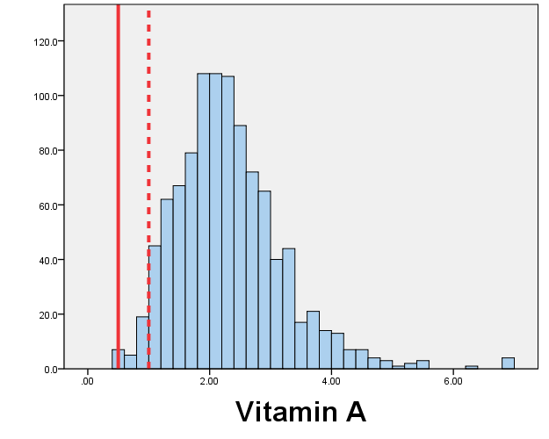
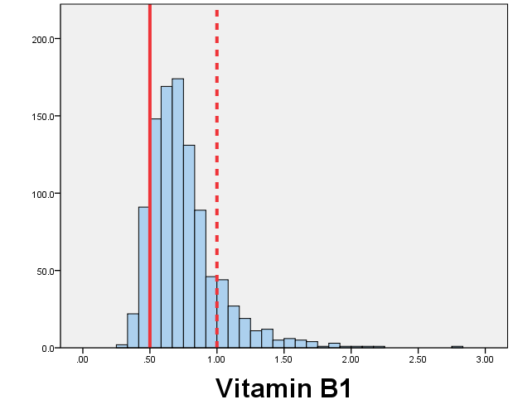
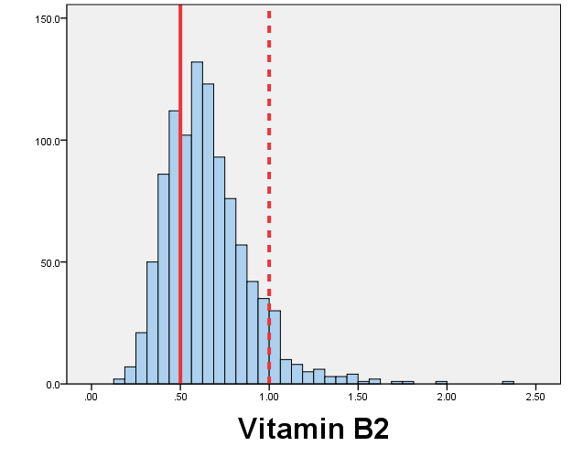
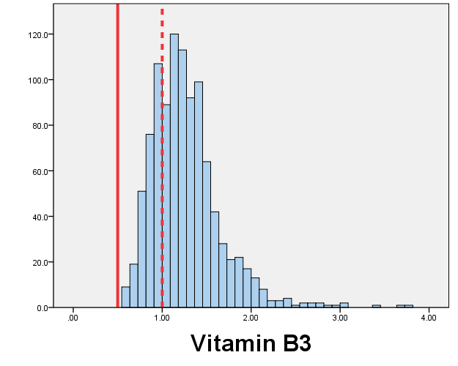
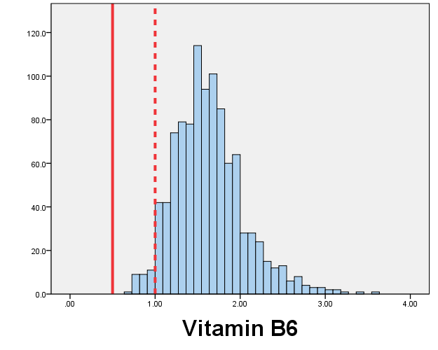
UK 1889-90
Energy & Nutrient Availability (inc alcohol) relative to UK 1991 Dept. of Health Recommended Nutrient Intake

Slide 12
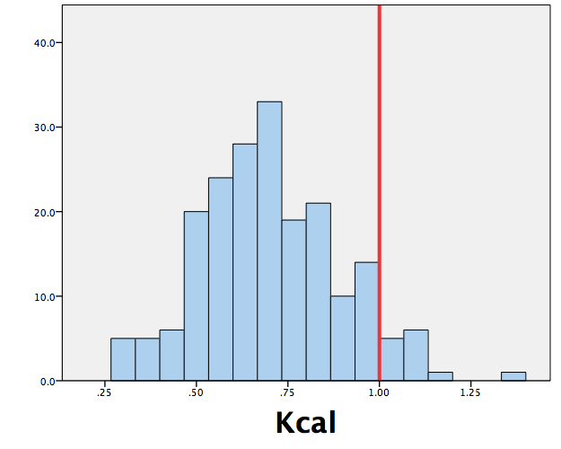
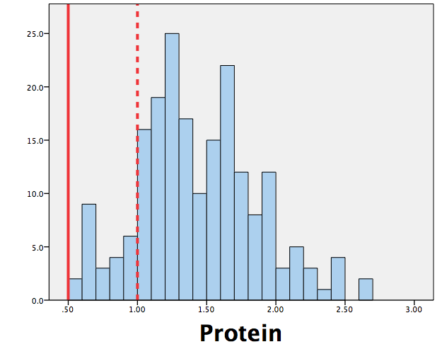
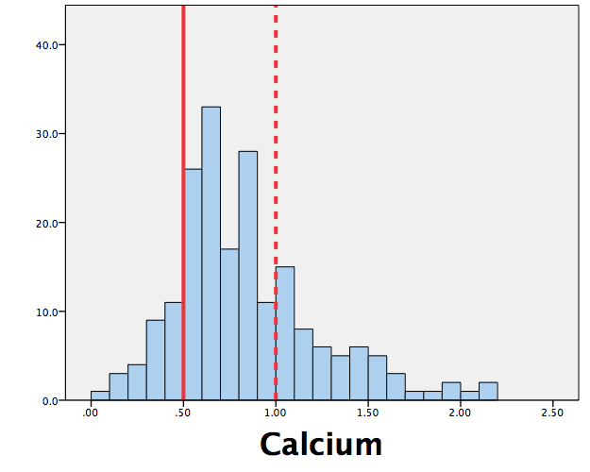
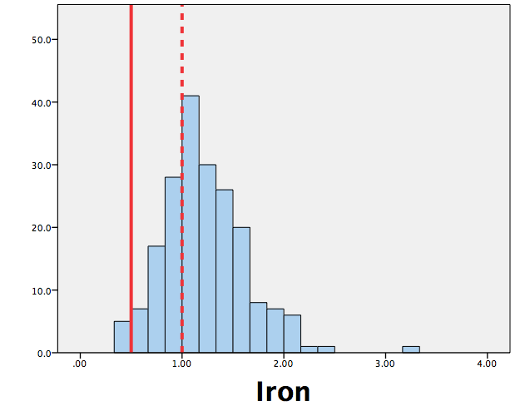
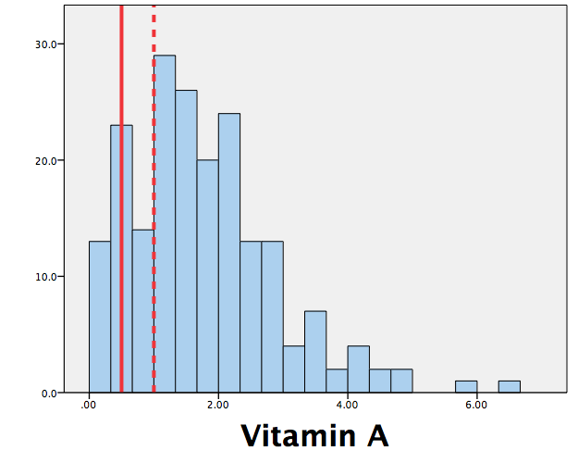
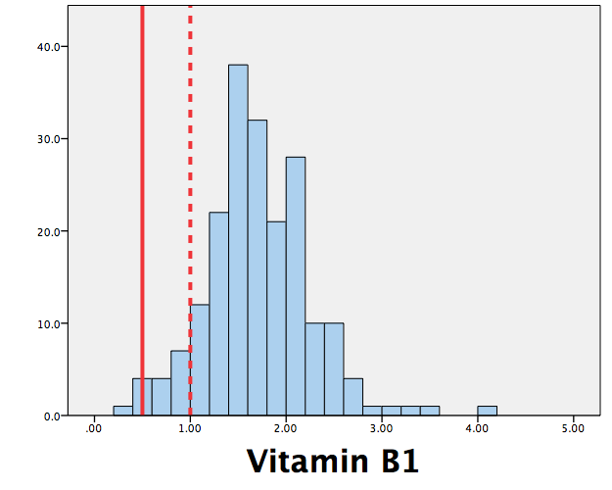
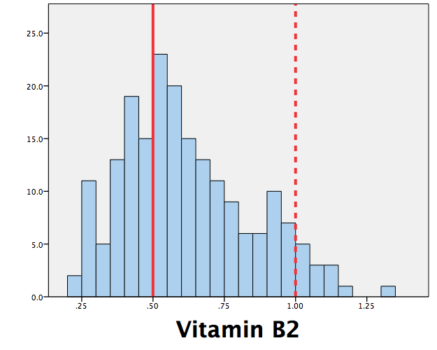
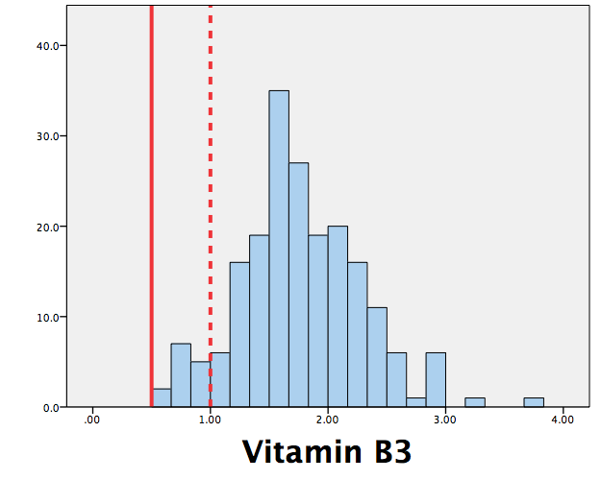
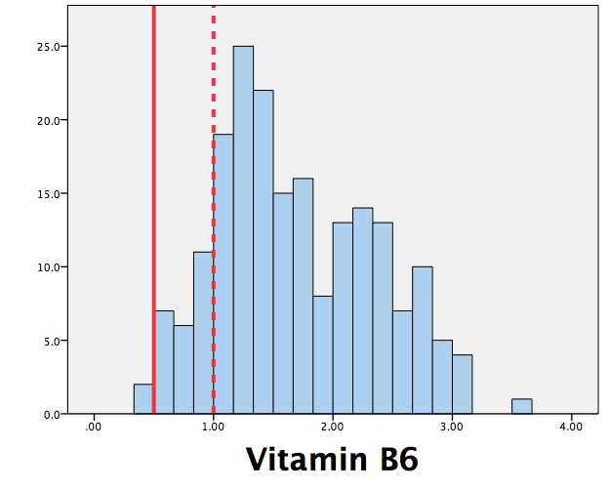
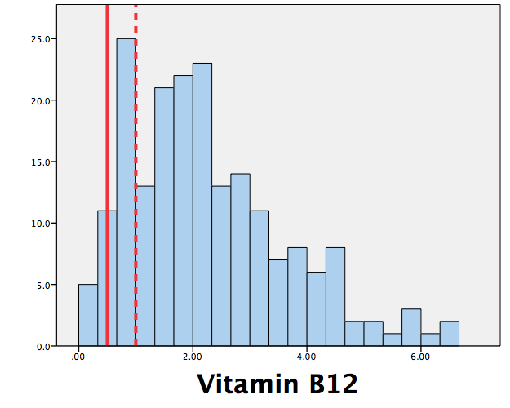
Germany 1889-90
Energy & Nutrient Availability (inc alcohol) relative to UK 1991 Dept. of Health Recommended Nutrient Intake

Slide 13
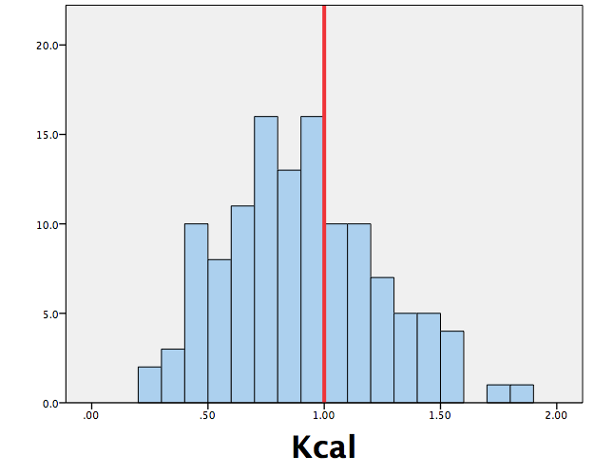
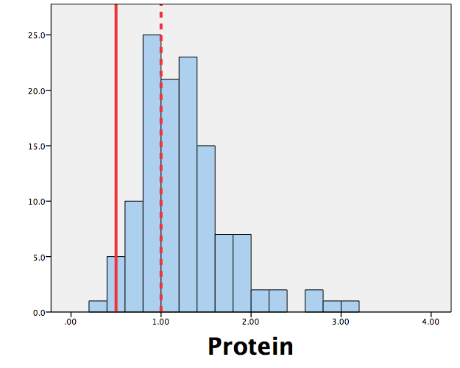
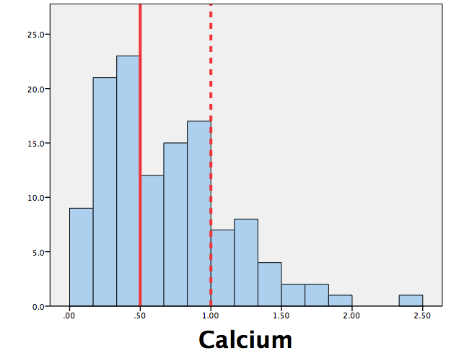
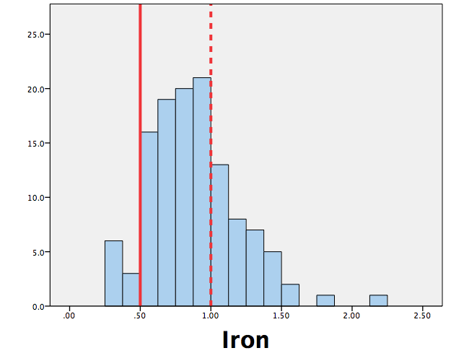
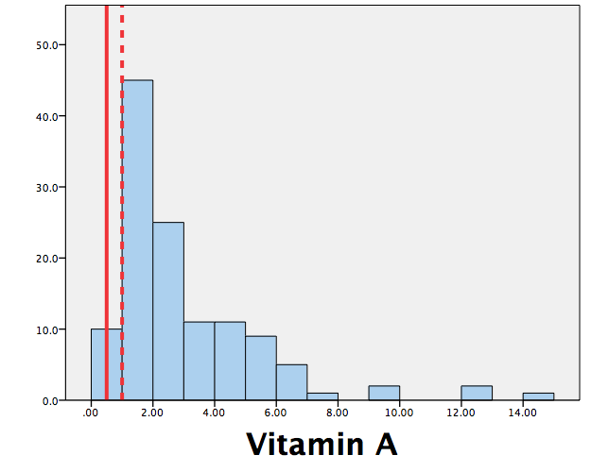
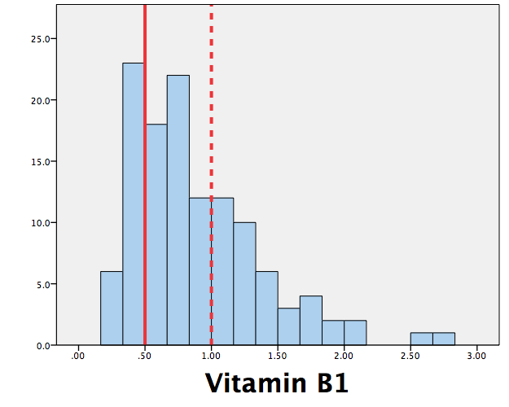
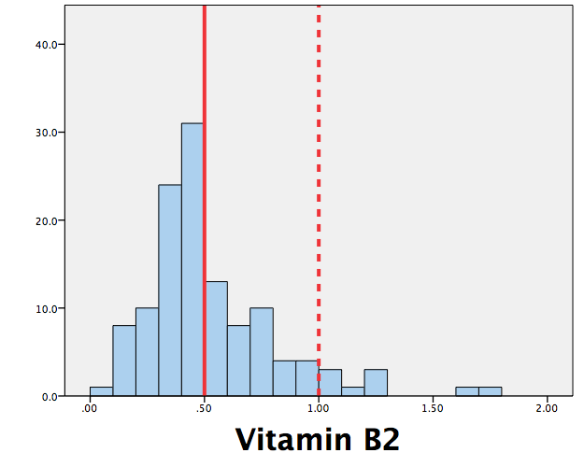
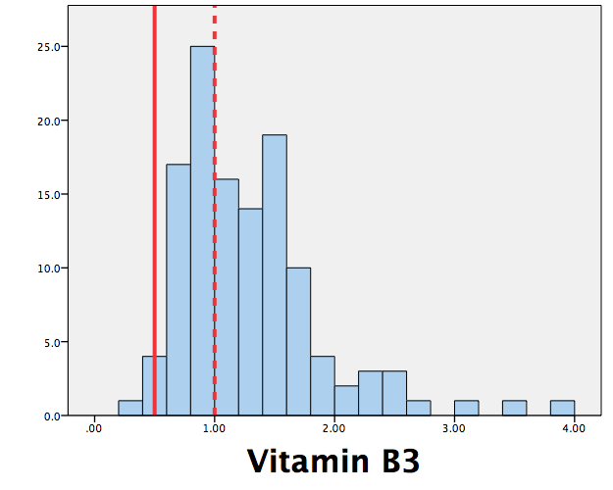
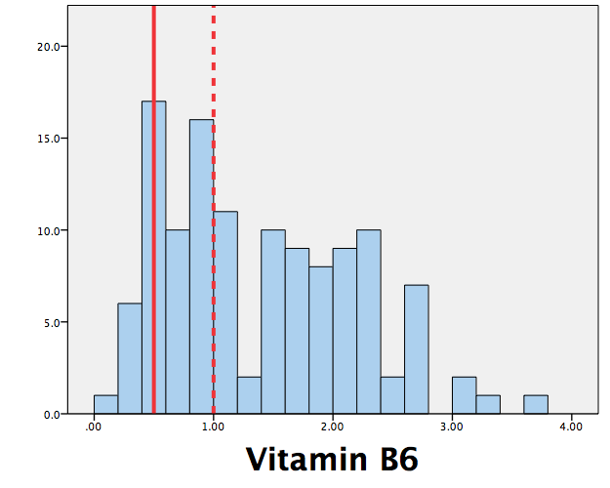
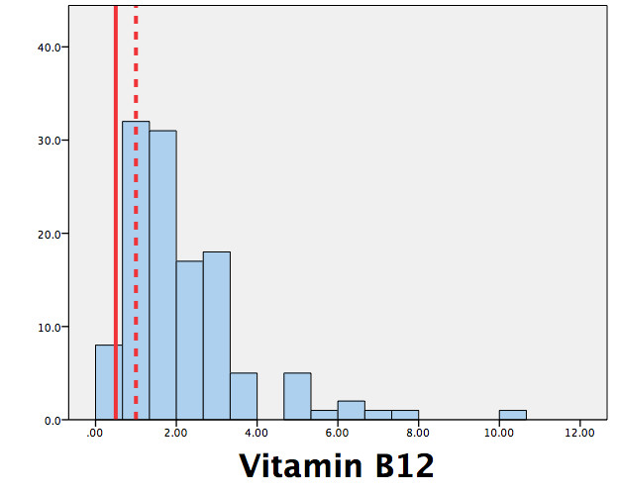
Belgium 1889-90
Energy & Nutrient Availability (inc alcohol) relative to UK 1991 Dept. of Health Recommended Nutrient Intake

Slide 14
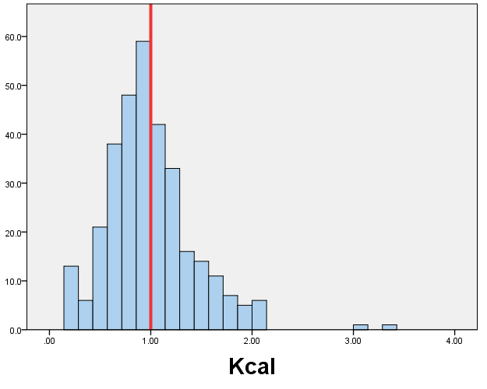
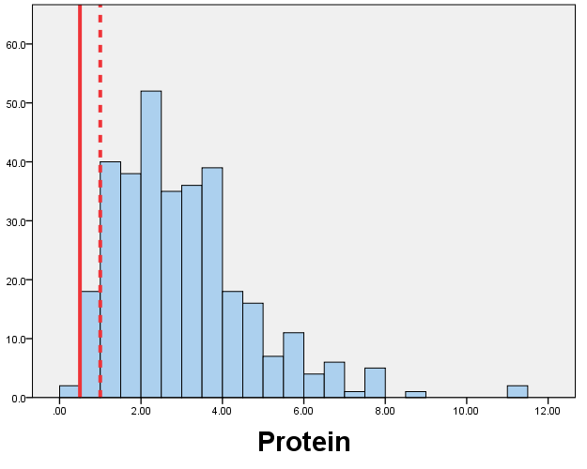
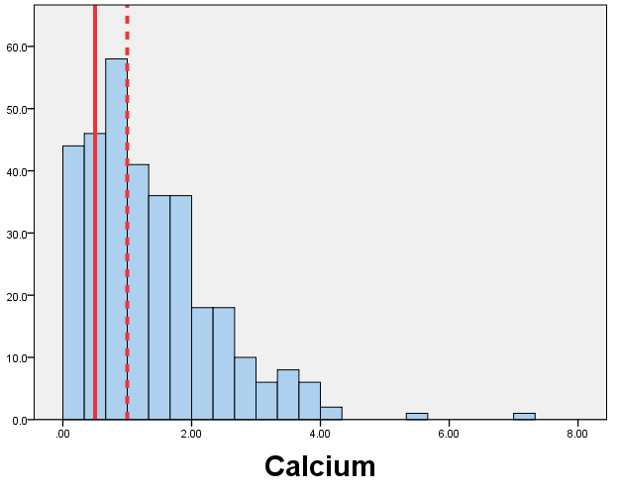
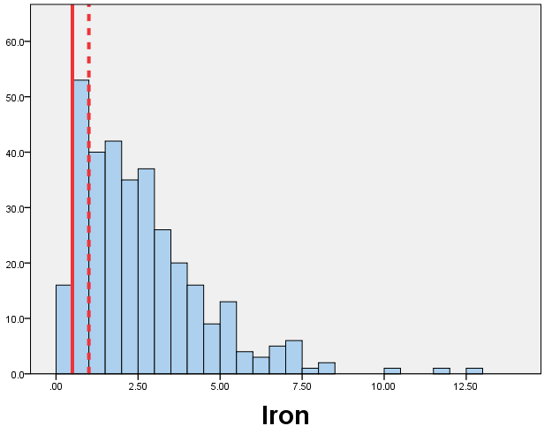
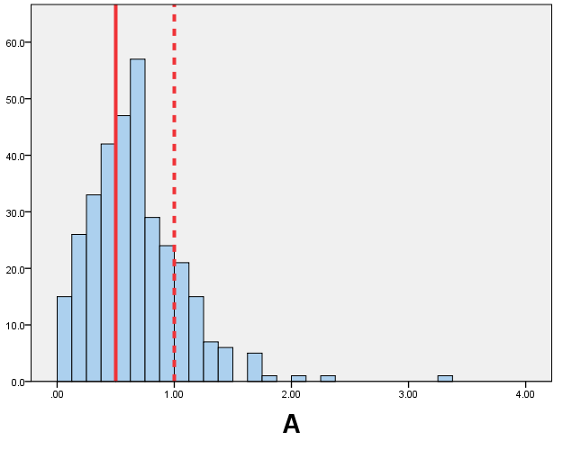
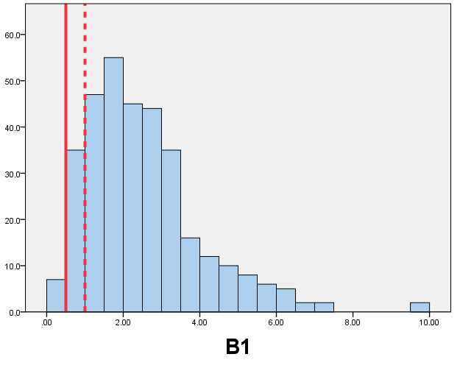
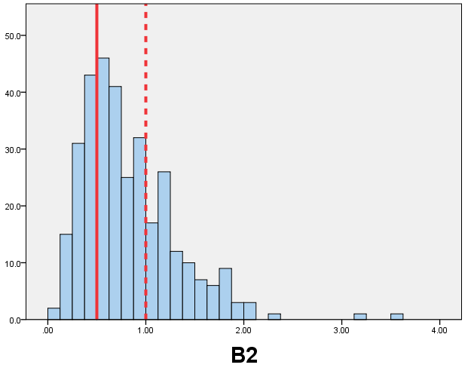
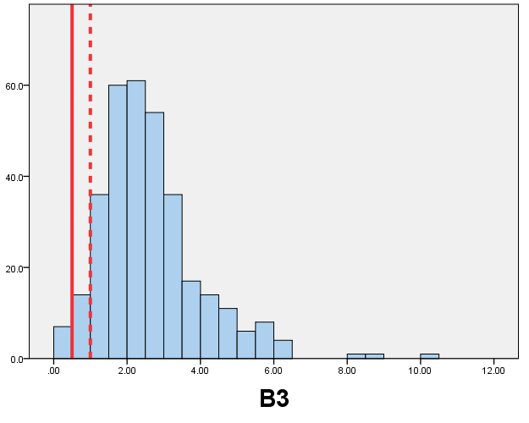
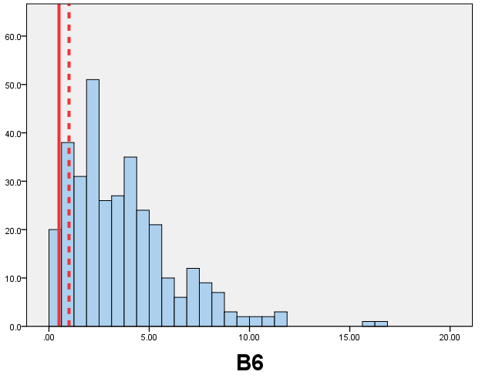
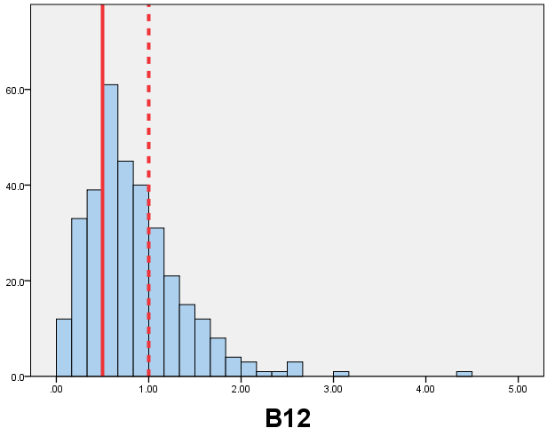
France 1889-90
Energy & Nutrient Availability relative to UK 1991 Dept. of Health Recommended Nutrient Intake

Slide 15
Summary of likely nutrient deficiencies relative to 0.5 RNI
Energy (UK, esp Germany, Belgium). Centre of distribution USA, right of centre, other countries.
Calcium (all countries, continental European better than USA or UK)
Vit B2 (all countries)
Vit B12 (not USA)
Vit A (all countries)
Not Protein, Vit B1, Vit B3, Vit B6 – satisfied in nearly all households in all five countries.
Not Iron, but very sensitive to composition of meat category – liver in particular

Slide 16
Likely impact of deficiencies
Calcium: essential for bones and teeth (rickets in children, osteoporosis in adults)
Vit B1: essential for carbohydrate metabolism, nerve function, muscle coordination (in extremis beriberi)
Vit B2: essential for metabolism of all foods & proper functioning of Vit B3 & B6
Vit B3 essential for converting food to energy.
Vit B6 essential for protein metabolism.
Vit B12: builds genetic material & red blood cells (pernicious anemia)
Vit A: night vision, hair skin, bones, teeth (night blindness)

Slide 17
Headcount nutritional poverty & Nutritional gap
n = total population
q = population below nutritional poverty line
z = nutritional poverty line
y = nutrition of poor household
Average shortfall of population from nutritional poverty line, expressed as percentage of the nutritional poverty line

Slide 18
1889/90 Household energy nutrition poverty and poverty gaps
 | UK |  | USA |  | Germany |  | Belgium |  | France
 | HC | Gap | HC | Gap | HC | Gap | HC | Gap | HC | Gap
Kcal | 0.61 | 0.10 | 0.48 | 0.06 | 0.93 | 0.30 | 0.65 | 0.19 | 0.87 | 0.28
Protein | 0.19 | 0.02 | 0.11 | 0.01 | 0.12 | 0.03 | 0.34 | 0.07 | 0.11 | 0.04
Calcium | 0.95 | 0.46 | 0.93 | 0.33 | 0.72 | 0.25 | 0.80 | 0.38 | 0.36 | 0.10
Iron | 0.88 | 0.24 | 0.72 | 0.12 | 0.29 | 0.06 | 0.70 | 0.19 | 0.46 | 0.11
Vitamin B1 | 0.86 | 0.26 | 0.79 | 0.16 | 0.08 | 0.02 | 0.66 | 0.25 | 0.31 | 0.08
Vitamin B2 | 0.93 | 0.33 | 0.76 | 0.18 | 0.93 | 0.38 | 0.93 | 0.48 | 0.88 | 0.38
Vitamin B3 | 0.26 | 0.03 | 0.17 | 0.02 | 0.07 | 0.15 | 0.39 | 0.08 | 0.13 | 0.04
Vitamin B6 | 0.03 | 0.00 | 0.09 | 0.01 | 0.13 | 0.03 | 0.41 | 0.15 | 0.57 | 0.16
Vitamin B12 | 0.01 | 0.00 | 0.01 | 0.00 | 0.21 | 0.01 | 0.15 | 0.05 | 0.16 | 0.06
Vitamin A | 0.04 | 0.01 | 0.03 | 0.01 | 0.25 | 0.11 | 0.08 | 0.02 | 0.06 | 0.01
Vitamin C | 0.90 | 0.32 | 0.84 | 0.24 | 0.77 | 0.45 | 0.74 | 0.41 | 0.79 | 0.40

Slide 19
Food Share
obvious and simple method of welfare comparison across time and place.
Uses within survey data exclusively
Expect poor households, by virtue of low income or large family size, to have higher food share.

Slide 20
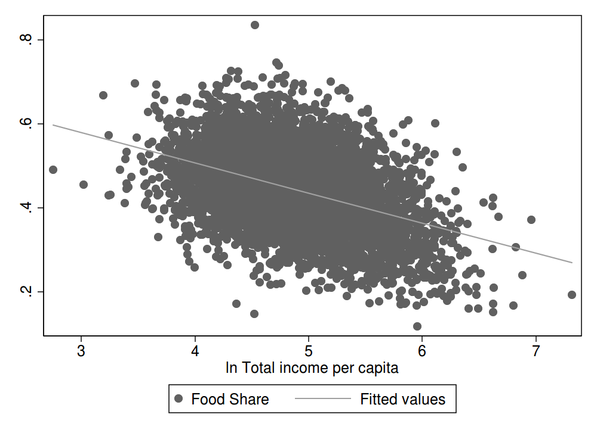




USA
UK
Budget Share Engel Curves
Food Share by log Total Income per capita
France
Germany
Belgium

Slide 21
Mean Food Shares Energy Deprivation (HC)
1st USA 0.44 1st USA 0.48
2nd Belgium 0.48 2nd UK 0.61
3rd France 0.49 3rd Belgium 0.65
4th=UK 0.50 4th France 0.87
4th=Germany 0.50 5thGermany 0.93
Hard to accept FS as measure of welfare, given evidence on nutrition. Rank ordering of countries somewhat different to RO based upon nutritional analysis.
Energy deprivation is proportion of households where diet does not provide sufficient Kcal to meet RNI based on 2.2 PAL

Slide 22
Cost of energy (Kcal), real energy wage
 | Cost of Kcal (Cents per 1000 Kcal) | Husband’s Weekly Income ($) | Real energy wage
USA | 6.41 | 10.17 | 159
UK | 6.42 | 7.65 | 119
Germany | 5.00 | 4.19 | 84
Belgium | 4.89 | 5.21 | 107
France | 6.24 | 5.27 | 84

Slide 23
Conclusions
HC nutritional poverty and nutritional gap offer alternate welfare measures to food share and provide a different rank ordering of countries.
All countries have a substantial proportion of households with a diet that provides insufficient energy. Best ‘physiological capital’ USA, worst Germany.
However, pattern of B vitamin deficiency suggests that energy shortfall evident in diets may have been exacerbated by low intakes of vitamins essential for efficient metabolism.
Calcium deprivation pervasive except for France. Likelihood of widespread incidence of rickets among children.
Lower resistance to disease, increased likelihood of infection. Consistent with McKeown thesis.
Reduction in ability to undertake sustained work (Fogel). And USCL sample skewed in favor of better-off workers

